Slide 1


UCLA MQE X SUM ZERO
Coach
Professor Samuel Borghese
Team 2
Mingyuan Li, Tanaporn Sriklay, Xinyue Wu
Notes:
Add names

Slide 2



MEET OUR TEAM
Mingyuan Li
Xinyue Wu
Tanaporn Sriklay

Slide 3
Introduction
Fundamental Idea
Data Processing
Algorithm 1
Algorithm 2
Q&A
CONTENTS

Slide 4
INTRODUCTION

Slide 5
INTRODUCTION
SUMZERO: INVESTMENT DATA ANALYSIS
Target : Using data provided by a buy-side investment platform, students will identify a signal that consistently beats the S&P year-over-year
Procedures of Algorithm 1 & 2
Cleaning and combine all dataset
Filtering valuable securities from cleaning dataset
Running Algorithm Model
Revise Algorithm to find the optimal outcome

Slide 6
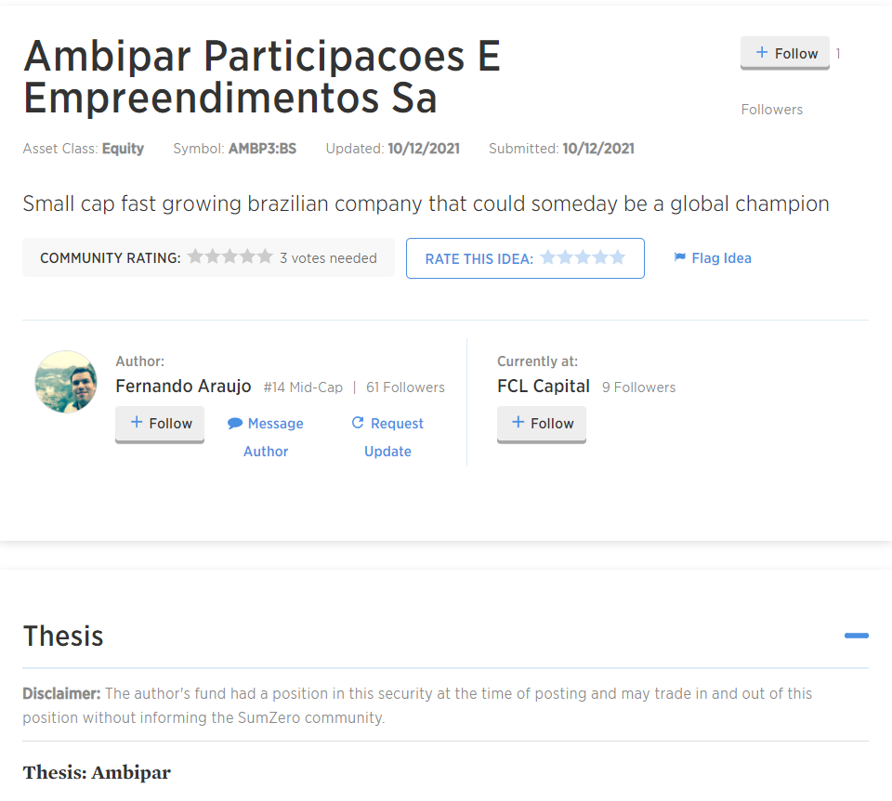
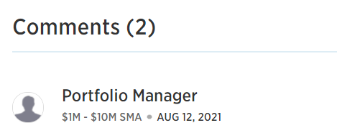


FUNDAMENTAL IDEA
Data Background : Sumzero Dataset
IDEA Table
Idea Relative Table
Ideas
Comments
Author
likes
Followers
Thesis

Slide 7
FUNDAMENTAL IDEA
Selecting Data
IDEA Table:
Initial ideas body and updated ideas body
Comments body
Idea Relative Table:
Ideas available time
Comments available time

Slide 8
FUNDAMENTAL IDEA
Ideas on Modeling
Processing ideas body or comments body using NLP
Constructing a linear regression model on ideas/comments and stock’s return
Choosing the stocks based on some criterions or strategies
Build the ideas sentiment index using the Sumzero data
Build the comments sentiment index using the Sumzero data

Slide 9
DATA PROCESSING
Setting data range, rolling period, and training and testing set
Choosing the daily data range from 2016-08-31 to 2021-07-31.
Setting the rolling period equals three months.
Selecting tickers that have more than 20 ideas (including updated ideas).
Splitting the data into the training set (2016-08-31 to 2020-07-31) and the testing set (2020-08-01 to 2021-07-31)

Slide 10
ALGORITHM 1
Notes:
Introduce our first algorithm, which is build a Sumzero sentiment index.

Slide 11
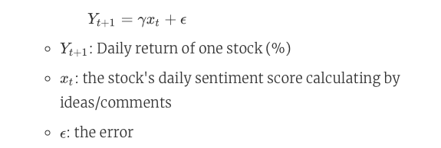
Algorithm 1: MODELING
Construct a linear regression model

Slide 12
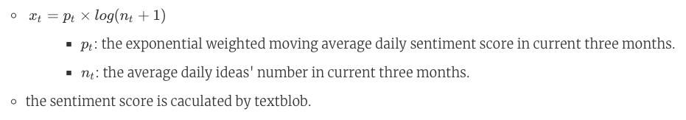
Algorithm 1:
MODELING
Calculate X_t
Notes:
Fit the X and Y using simple linear regression and get each stock's coefficient, which we called it gamma.Fit the X and Y using simple linear regression and get each stock's coefficient, which we called it gamma.
Build a strategy: pick the stocks that its gamma > 0.
Calculate the portfolio return using equal weight and weighted by volume, and compare the results with S&P 500.

Slide 13
Algorithm 1: RESULTS
Results Summary
The return on the ideas sentiment index and the comments sentiment index are both better than S&P 500.
The ideas sentiment index is slightly better than the comments sentiment Index compared to the whole performance above.
Index weighted by volume is better than the equal-weighted index.
The probability of both indexes winning the S&P 500 are 60.08% and 60.47%.
Notes:
We also found that...
….Indicating we built a successful portfolio.

Slide 14
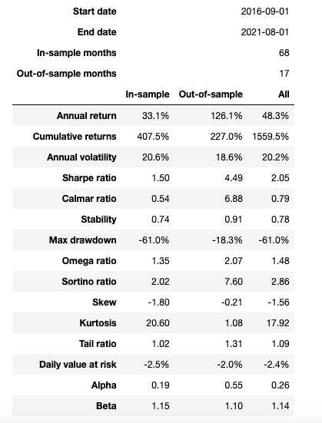
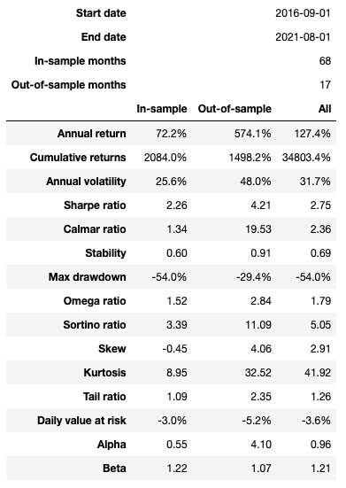
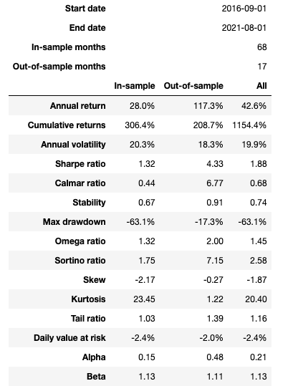
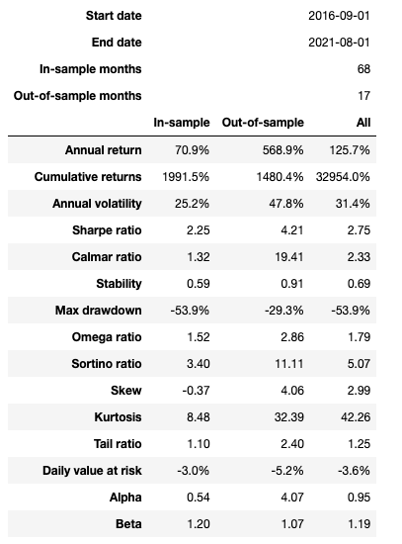
Algorithm 1 RESULTS: TECHNICAL INDICATORS
Ideas sentiment index
(equal weighted)
Ideas sentiment index
(weight by volume)
Comments sentiment index
(equal weighted)
Comments sentiment index
(weight by volume)
Notes:
This slide shows many technical indicators, like annual returns, cumulative returns, sharpe ratio, alpha, beta and etc.
I will analyze these technical indicators using different plots.

Slide 15
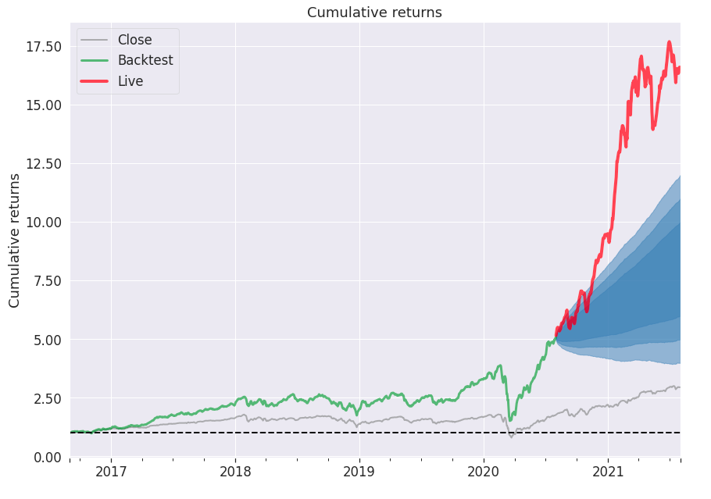
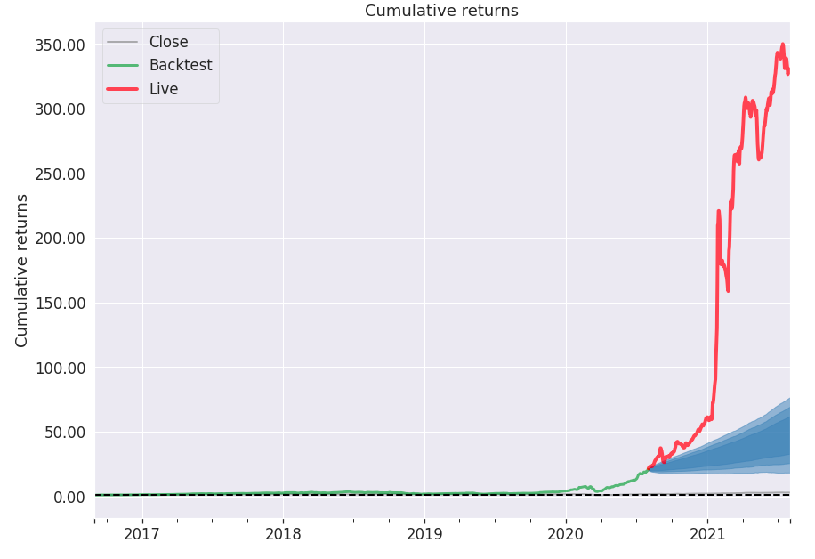
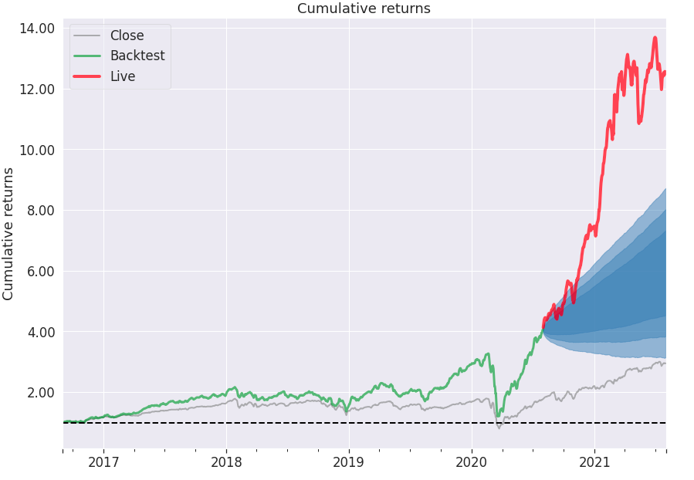
Algorithm 1 RESULTS: CUMULATIVE RETURNS
Ideas sentiment index (equal weighted)
Ideas sentiment index (weight by volume)
Comments sentiment index (equal weighted)
Comments sentiment index (weight by volume)
Notes:
Which means tha

Slide 16
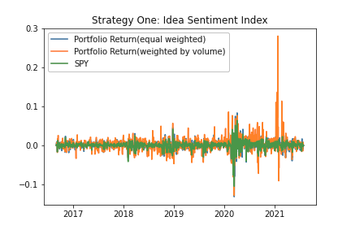

Algorithm 1 RESULTS: RETURNS
Ideas sentiment index
Comments sentiment index

Slide 17
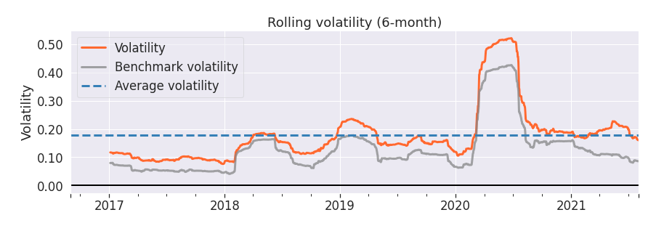
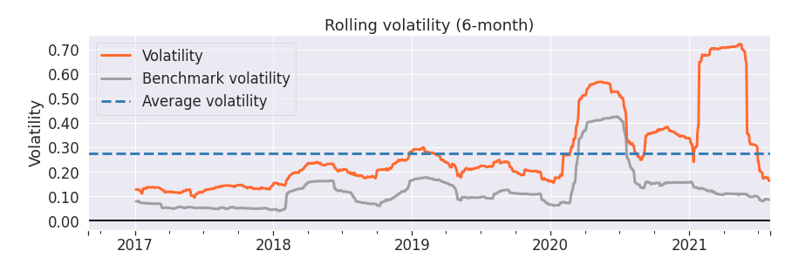
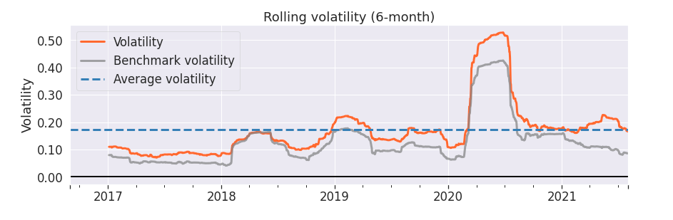
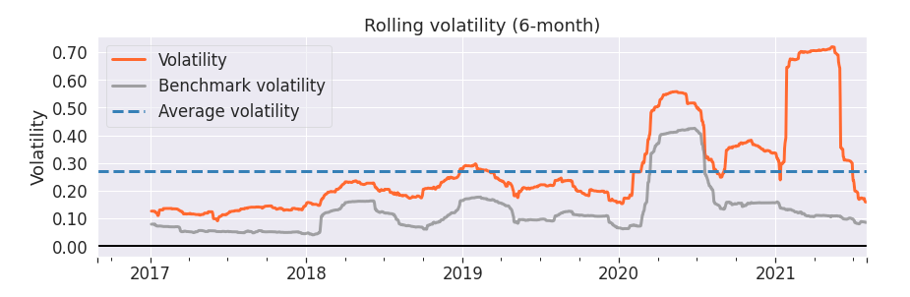
Algorithm 1 RESULTS: ROLLING VOLATILITY
Ideas sentiment index (equal weighted)
Ideas sentiment index (weight by volume)
Comments sentiment index (equal weighted)
Comments sentiment index (weight by volume)

Slide 18
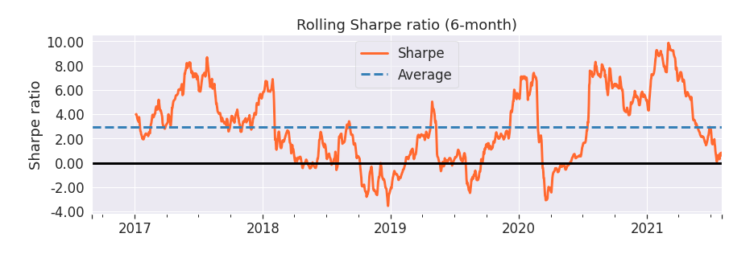
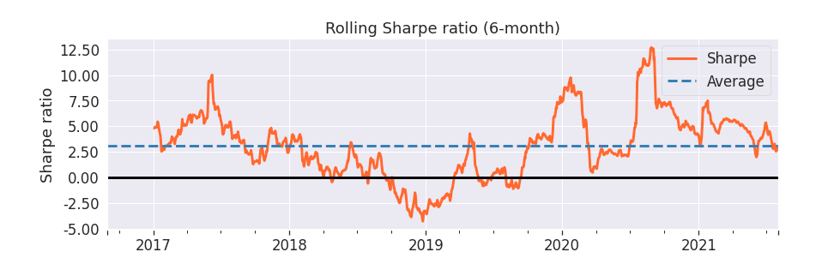
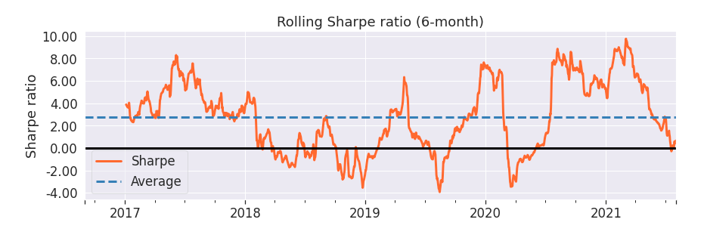
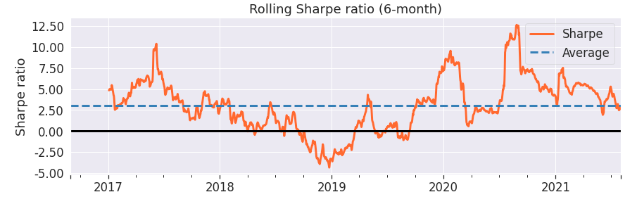
Algorithm 1 RESULTS: ROLLING SHARPE RATIO
Ideas sentiment index (equal weighted)
Ideas sentiment index (weight by volume)
Comments sentiment index (equal weighted)
Comments sentiment index (weight by volume)

Slide 19
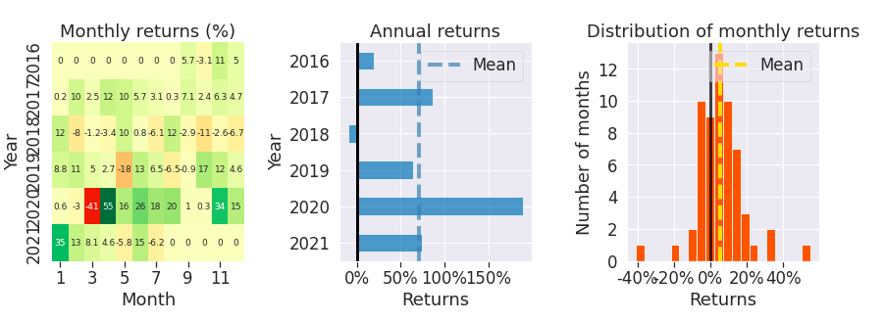
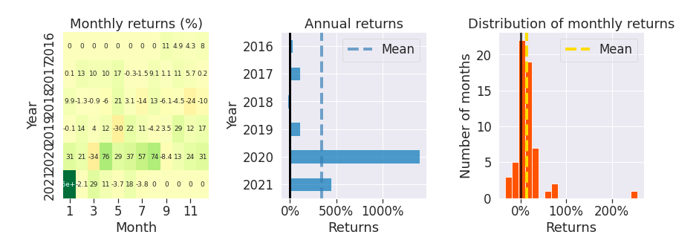
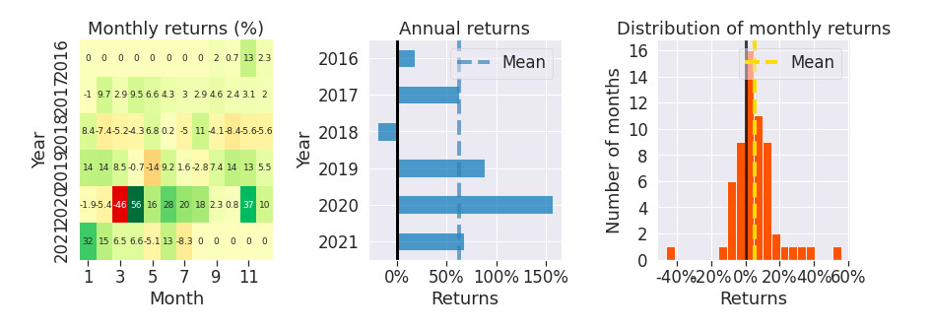
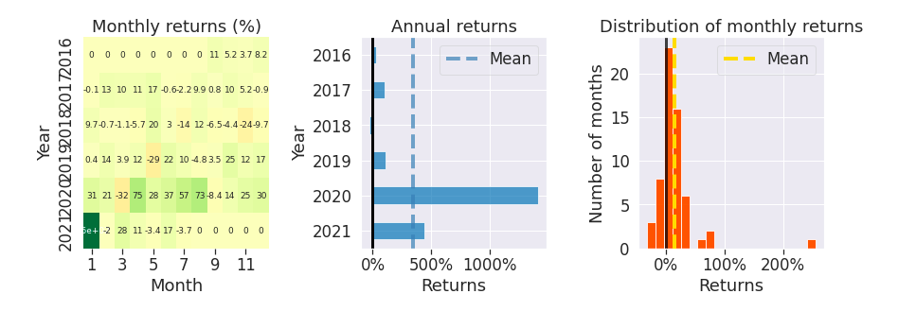
Algorithm 1 RESULTS: MONTHLY RETURNS, ANNUAL RETURNS, DISTRIBUTION OF MONTHLY RETURNS
Ideas sentiment index (equal weighted)
Ideas sentiment index (weight by volume)
Comments sentiment index (equal weighted)
Comments sentiment index (weight by volume)

Slide 20
ALGORITHM 2
--- MODEL IMPROVEMENT

Slide 21
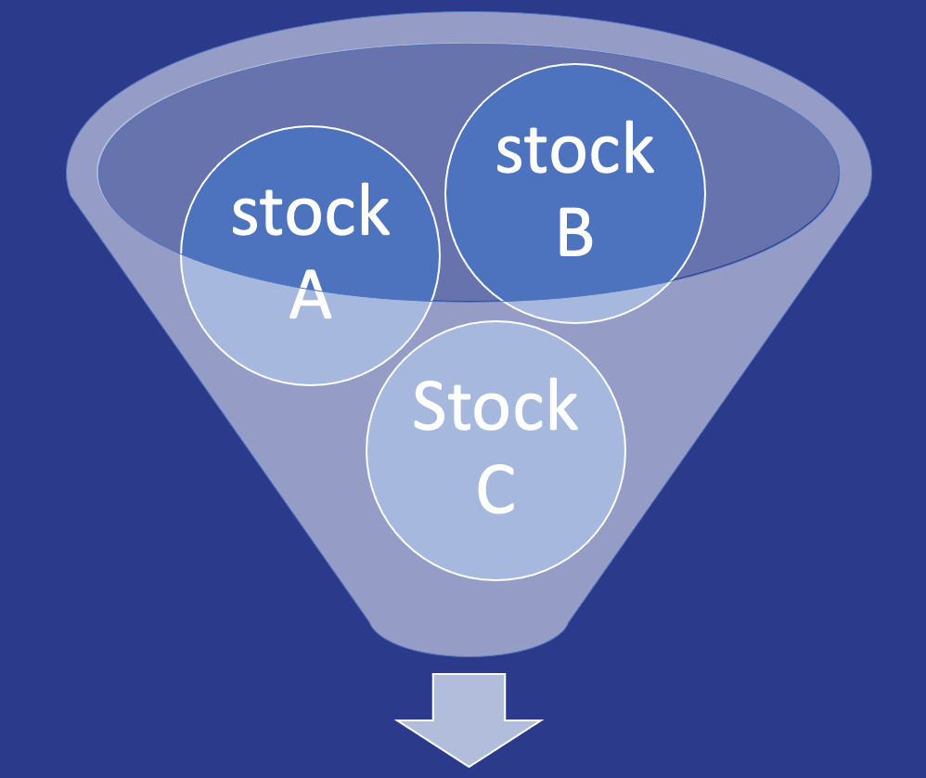
Algorithm 2: Motivation
Positive gramma based on regression using data from 2016-08-31 to 2020-07-31.
Modeling Adjustment :
Stock with less history will be eliminated from our portfolio
Evaluation before year 2020 shown in the previous graphs might be affected by data leak.
Selected stocks

Slide 22
Algorithm 2: General model for all stocks
Time series -> Pool Data
Have enough data
Using rolling “Rolling Window for Training and Testing”
Selected stocks

Slide 23
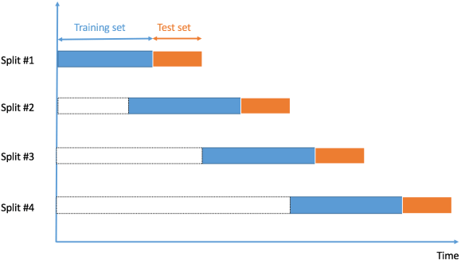
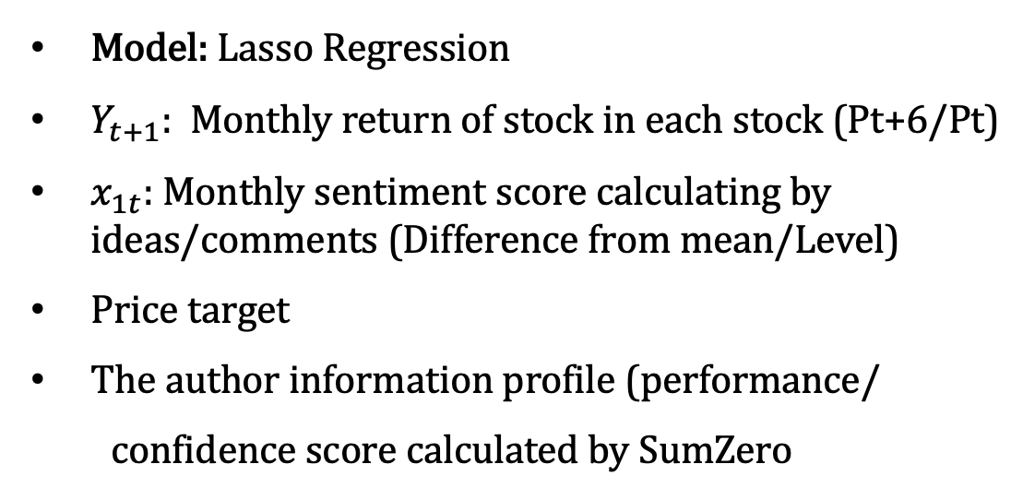
Algorithm 2 : Prevent Data Leak

Slide 24
Algorithm 2: Top 6 Stock Highest ROR
Rank ideas in each Month1 based on expected ROR of each stock
Month 1
Month 2
Month 3
Select Top 6 Expected ROR
Month 4
Our portfolio: Equally weighted

Slide 25
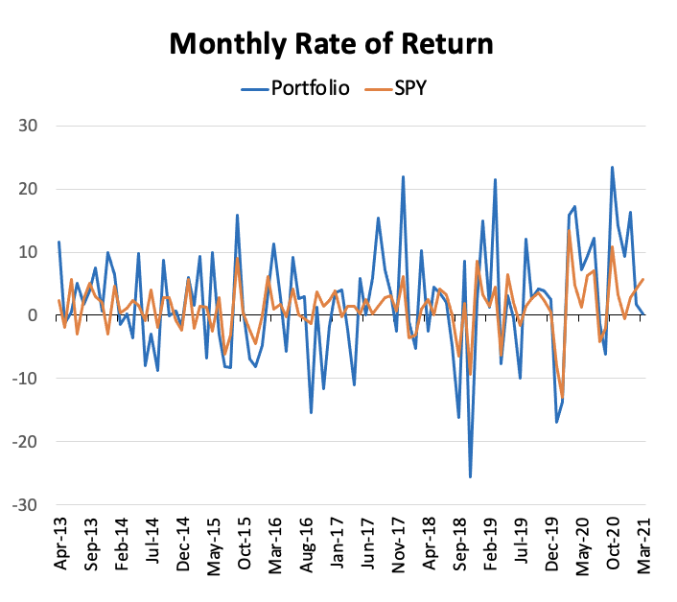
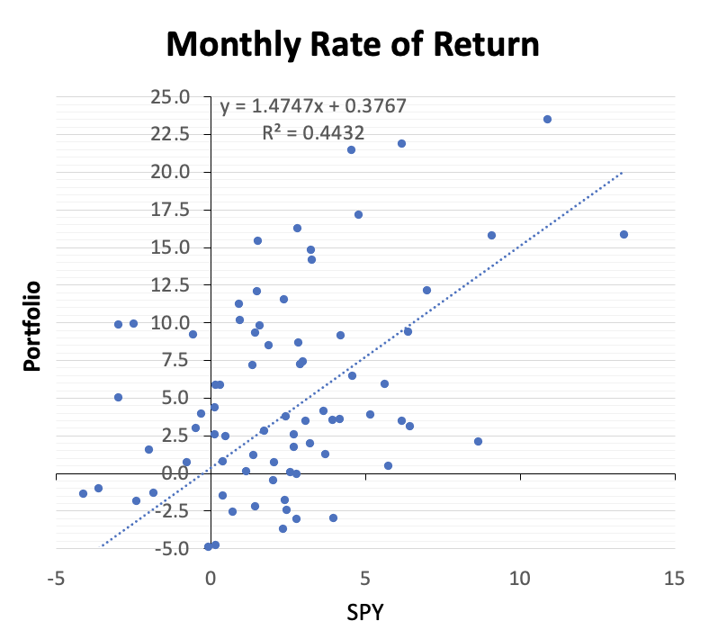
Algorithm 2: Average monthly ROA:1.87%
Portfolio: ROR = 2.1%, Sharpe ratio: 0.16
SPY: 1.1%

Slide 26
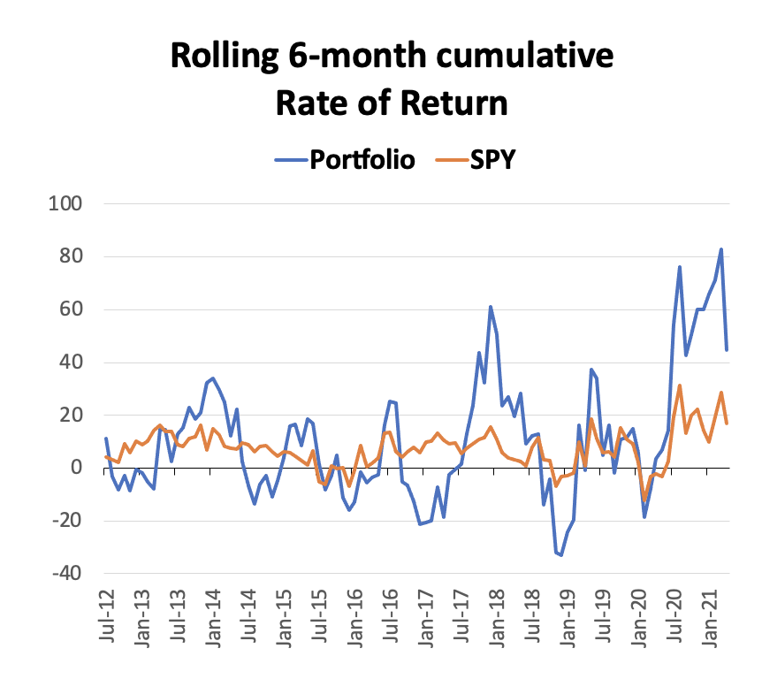
Algorithm 2: 6M Cumulative ROA:11.02%
Summary/Future Improvement
Forecast the cycle of economy
Economic upturn : selected stocks based on our algorithm
Economic downturn : Give more weight on low risk asset
Include time series for each stock
Apply other machine learning
Portfolio: 11.02%
SPY: 7.42%

Slide 27
Summary
Algorithm 1 ( Sentiment Security Alpha Selection ) : The Sentiment from Sum Zero IDEA and Comments could perfectly predictive the break out securities in a sentiment driven market esceplically the market after pandemic.
Algorithm 2 ( Machine Learning ) : The positive alpha outcome in the model prove that Machine Learning could leverage Sum Zero dataset into a effective portfolio.

Slide 28

“ Data is the new science. Big Data holds the answers. ”
–Pat Gelsinger.

Slide 29
Thank you for your time!
Q & A

